Slide 1


Investigating Cyber Psychology in the Context of User Behaviour and Email-Based Malware
Student: Mohamud Elmi
Supervisor: Razi Arshad
Date: 10 April 2025

Slide 2

Context & Problem
Phishing attacks exploit human error more than system flaws
Over 930,000 phishing incidents in Q3 2024
Cyberpsychology explains how attackers exploit habits, emotions and decision fatigue.

Slide 3
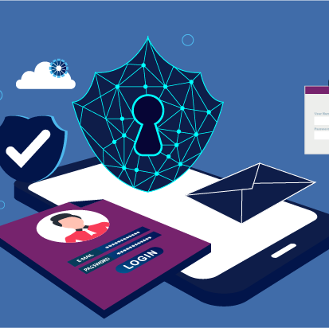
Aim & Objectives
Aim: To explore cyberpsychology's role in phishing susceptibility and test an intervention.
Objectives:
Identify psychological traits (e.g., authority bias, urgency effect)
Develop & implement a behaviourally-informed training video
Measure before/after impact with quizzes
Gather user feedback & confidence levels

Slide 4

Methodology
73 participants with varied digital experience
Pre-test quiz → 5-minute training video → Post-test quiz
Confidence measured via Likert-scale surveys

Slide 5

The Intervention
5-minute training video on phishing detection
Covered emotional manipulation & red flag indicators
Detection checklist integrated into the video
Leaderboard and certificates used for motivation

Slide 6
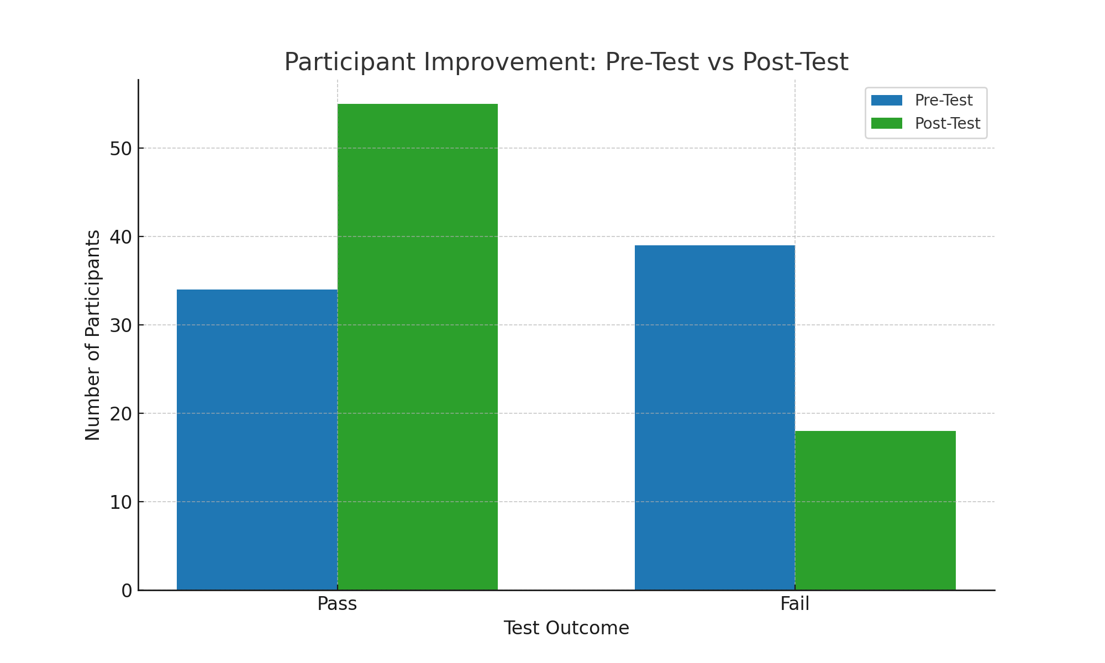
Results – Pre-Test vs Post-Test
Pre-Test Pass: 34 out of 73
Post-Test Pass: 55 out of 73
61.5% overall improvement after training

Slide 7
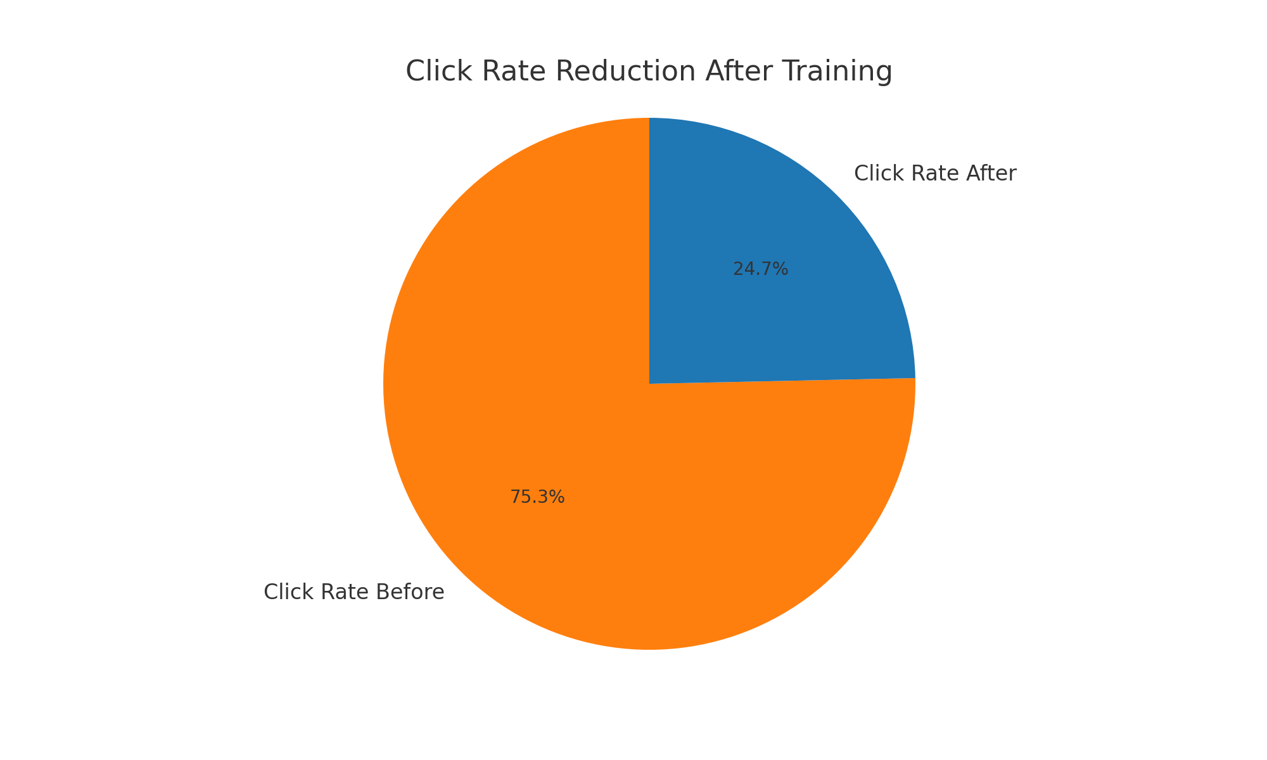
Click Rate Drop
Click-through rate dropped significantly post-training
Indicates improved caution and phishing detection
Confidence levels also increased

Slide 8
Feedback & Behavioural Insight
Most participants found the training clear and helpful
Confidence in identifying phishing increased
A few struggled with nuanced or subtle phishing cues

Slide 9

Strengths & Limitations
Strengths:
Realistic phishing scenarios based on behavioural manipulation
High participant engagement driven by gamified design
Limitations:
No demographic segmentation
Quizzes delivered online — environment not fully controlled
Small sample size

Slide 10
Future Work
Introduce adaptive training tailored to user performance
01
Implement long-term retention testing over months
02
Include demographic profiling for personalised insight
03
Expand to mobile platforms (SMS, social media phishing)
04

Slide 11

Practical Application
Deployable in schools, universities, and corporate settings
Minimal cost, scalable delivery
Focuses on behavioural change, not just awareness
Fits into cybersecurity onboarding or compliance training

Slide 12

Thank You
Questions?

